Slide 1
A Data Scientist’s story
Group - 21
Avinash
Yinxia Chen
Vinay
Zhijie Xu
Shiva Gandluri

Slide 2
Motivation
Significance
Curiosity to understand and study the trends in Data Science.
Determine the strongest skills and experiences to excel in Data Science
Analysis of Data Science applications in various fields of industry.
Helps us understand what tools, languages and backgrounds help us in becoming a successful Data Scientist
Provides insights into Data Scientist Salaries.

Slide 3
Data Source
Outcomes of the Project
Summary of Data
Source : Kaggle
Able to predict Data Scientist Salary, given his/her background information
Suggest tools, languages and project to work upon for a successful career in the field of Data Science.
Contains 16716 rows and 228 columns
Has a mixture of categorical and numerical data with some features containing NULL values.

Slide 4
Exploratory Data Analysis
Most of the participants were Male and were full time employed.
Most of the participants are from USA followed by India in the second place
The histogram of age feature is positively skewed stating most participants are in age group 20-25
About 70% of the Data Scientists have switched their careers from other areas.
Knowledge of Statistics,Python,R and Big data skills are most necessary skills and nice to have skills as per answers entered by the survey participants
Most unnecessary skill amongst all is having a knowledge of Enterprise tools, Degree, Kaggle Rankings

Slide 5
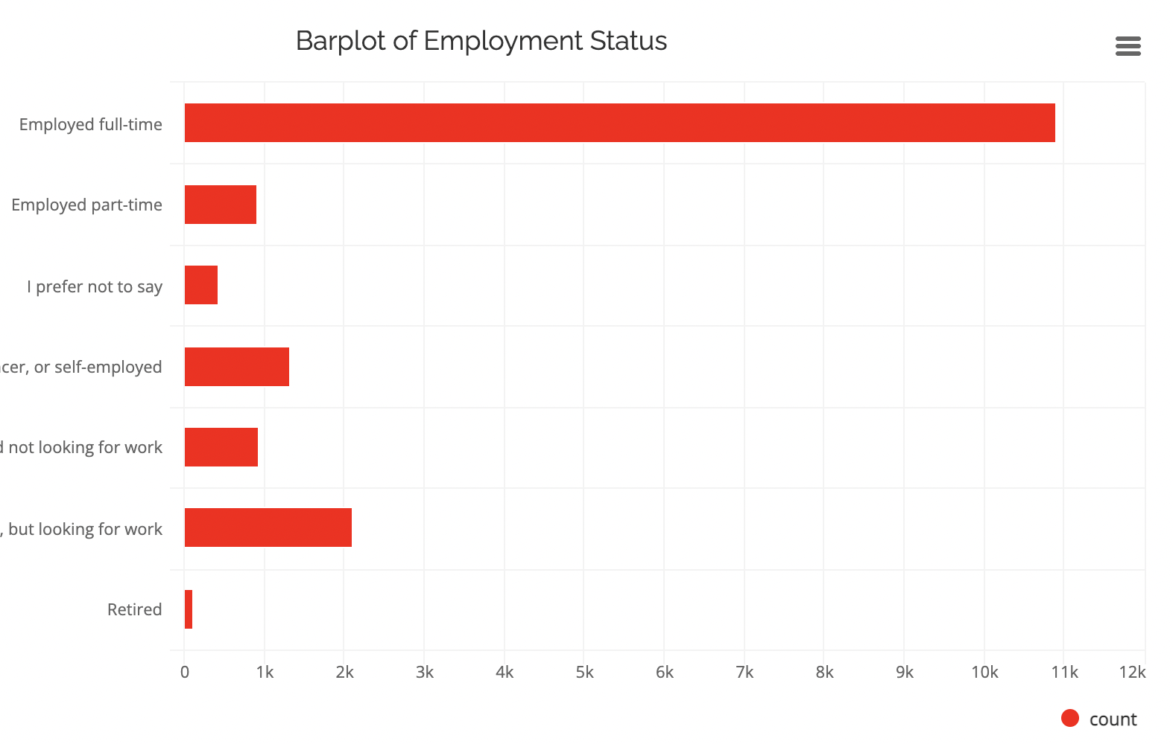
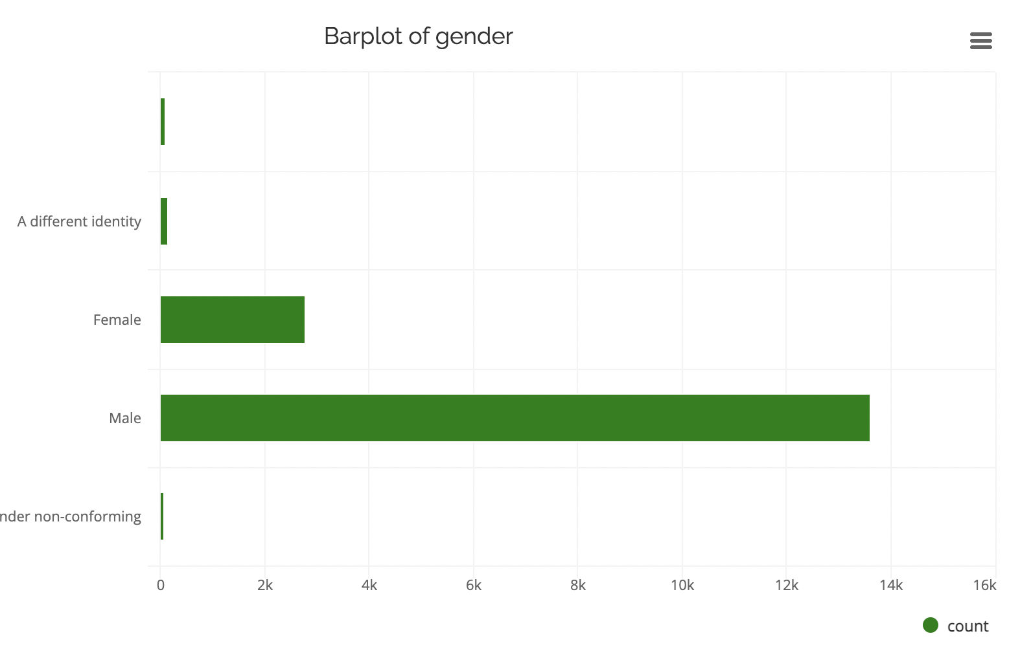
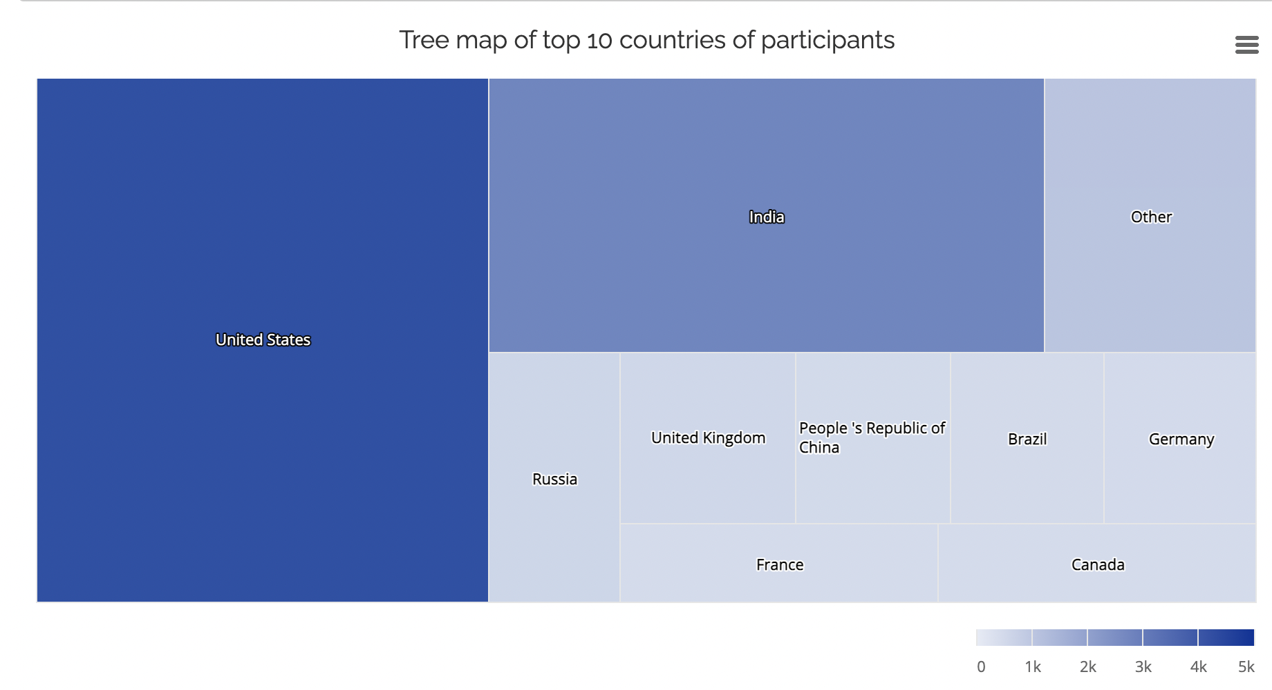
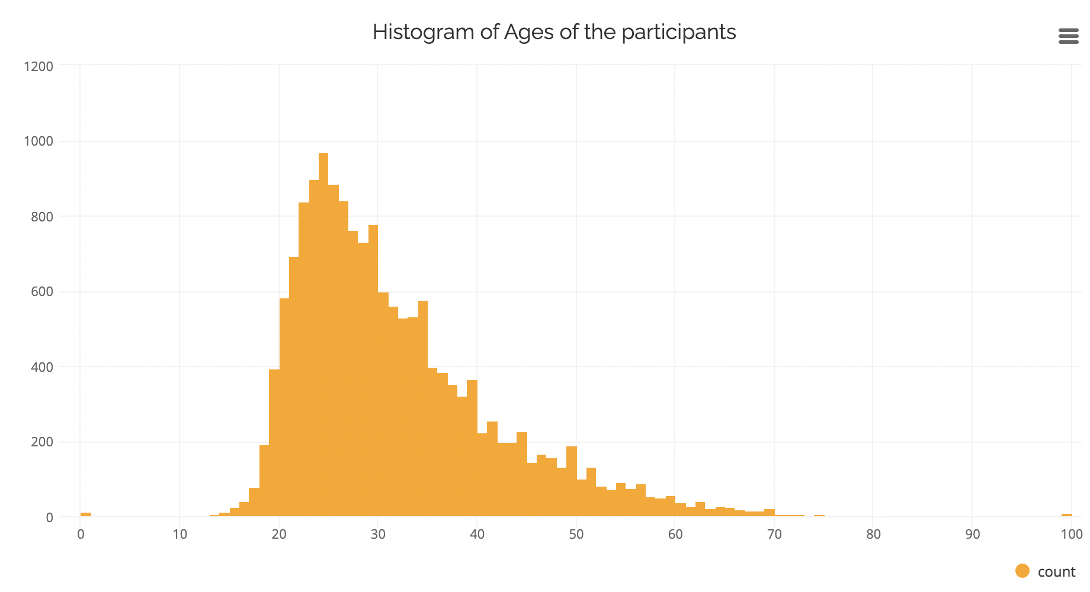
Observations

Slide 6
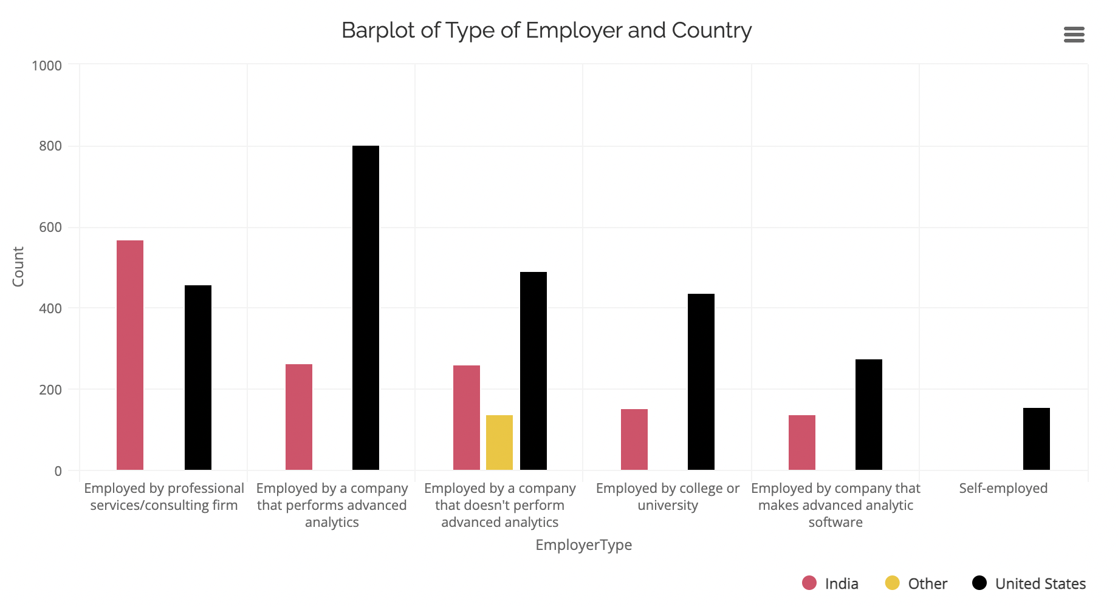
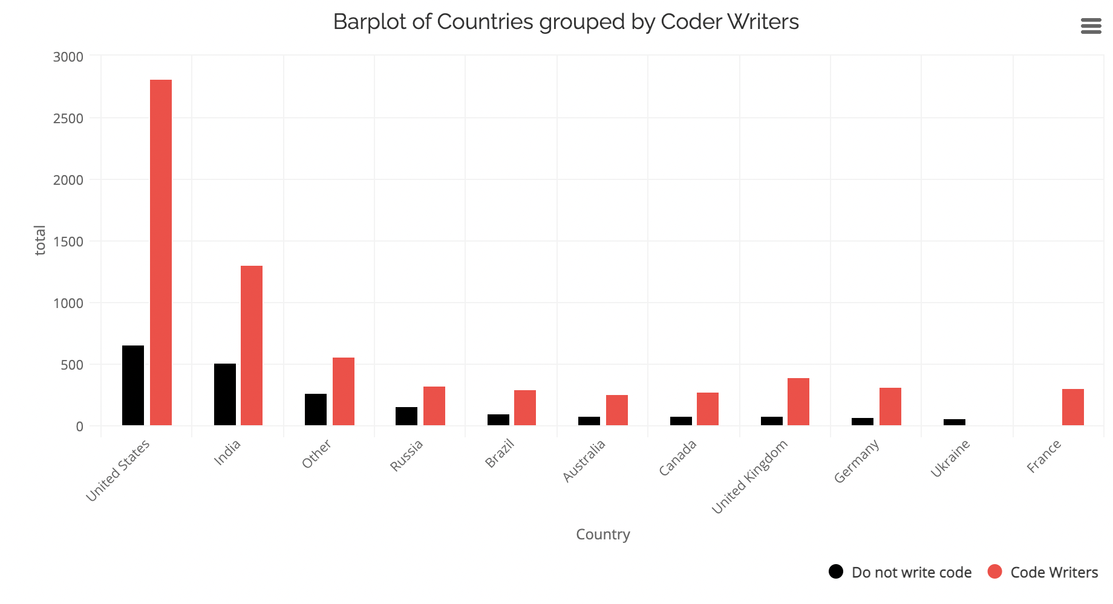
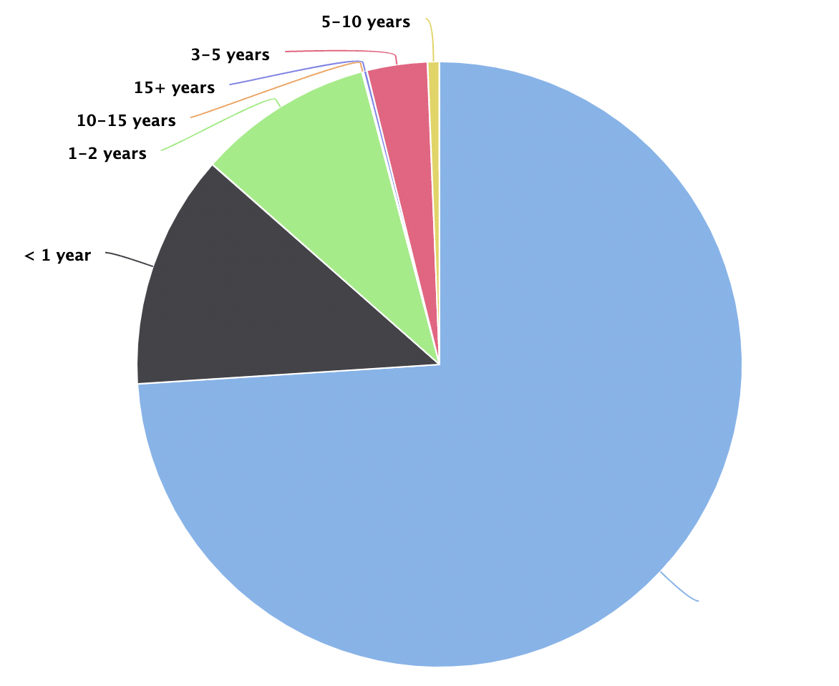
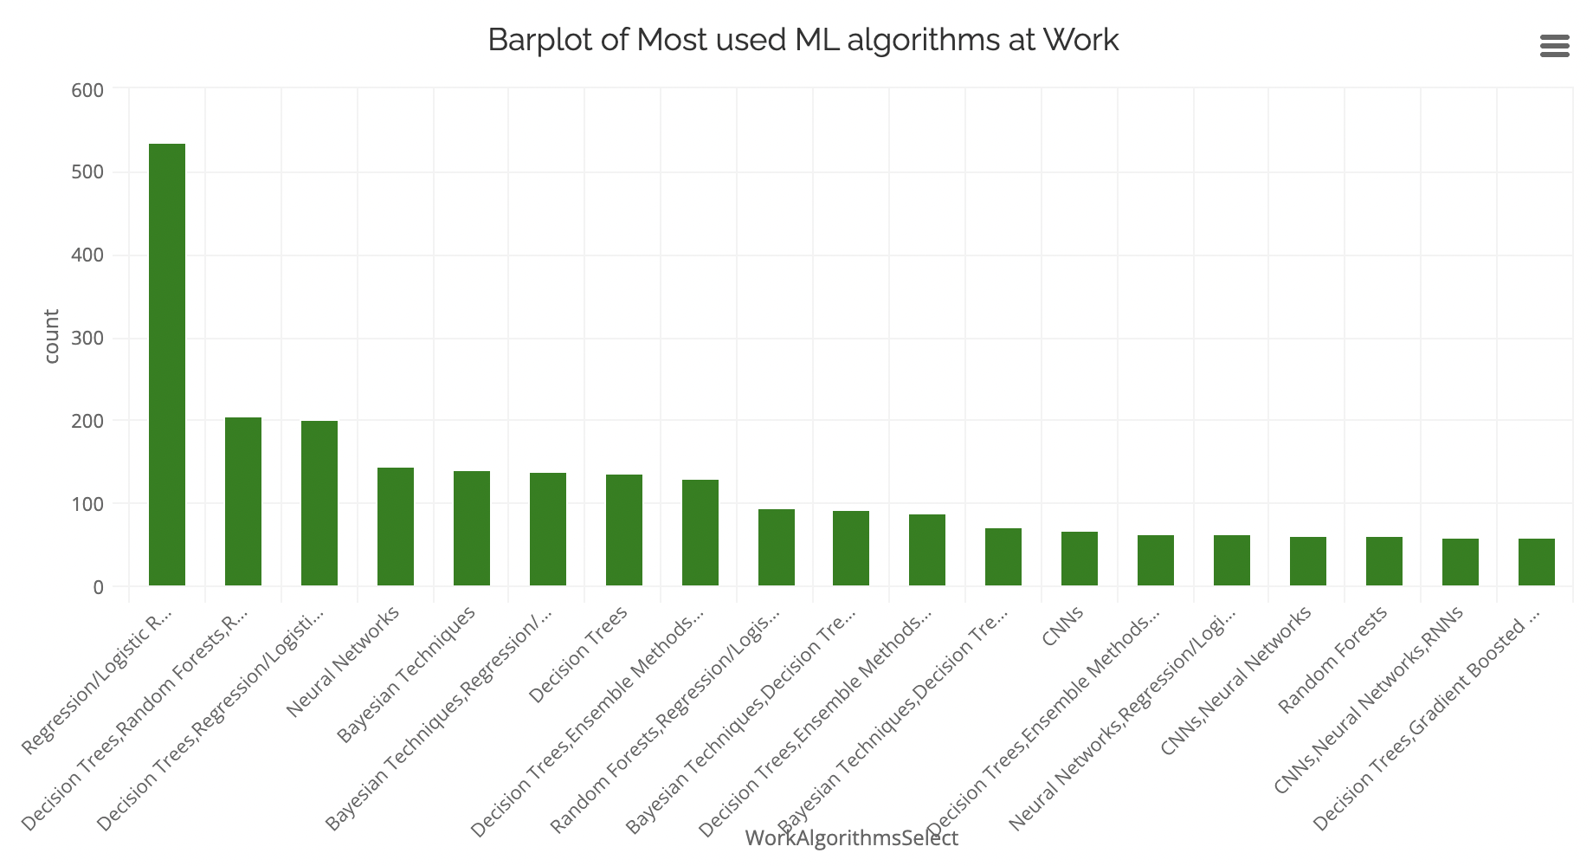
Observations
2-3 years

Slide 7
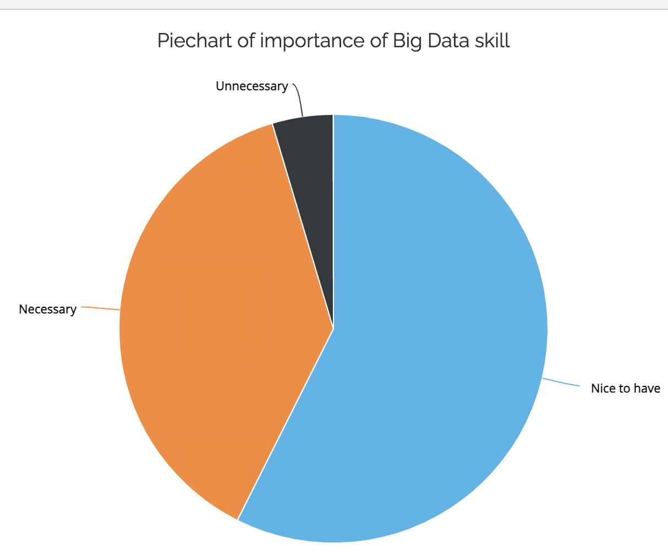
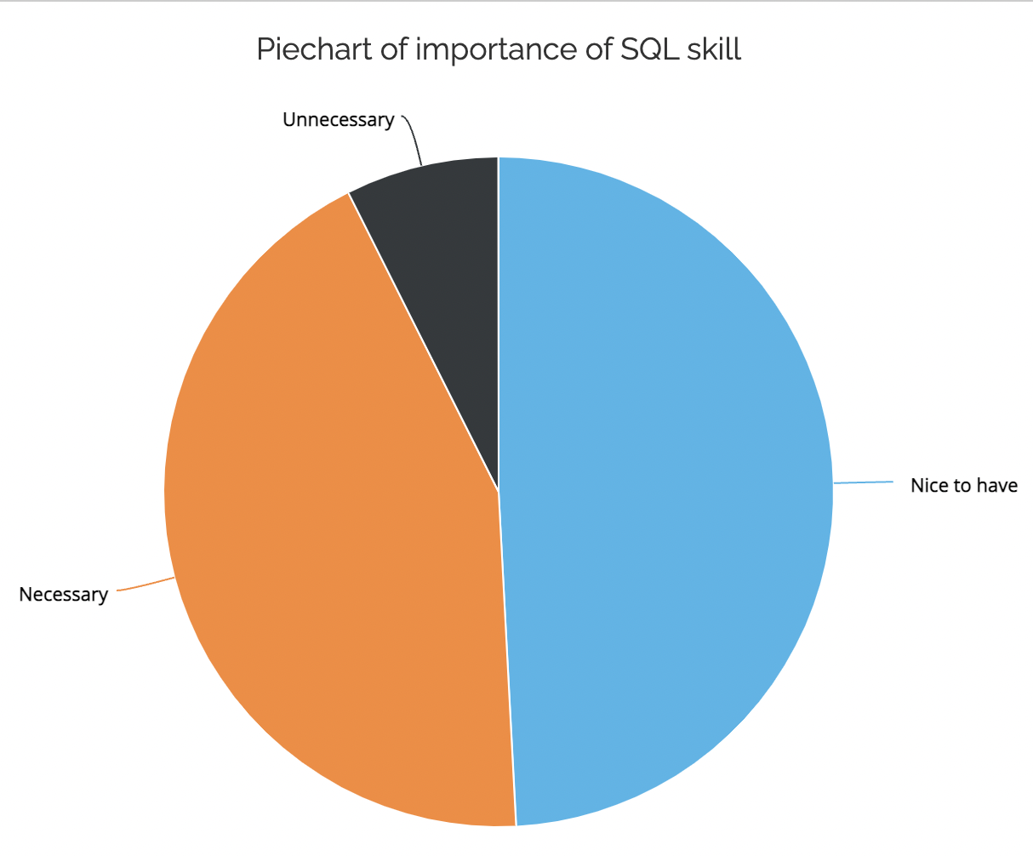
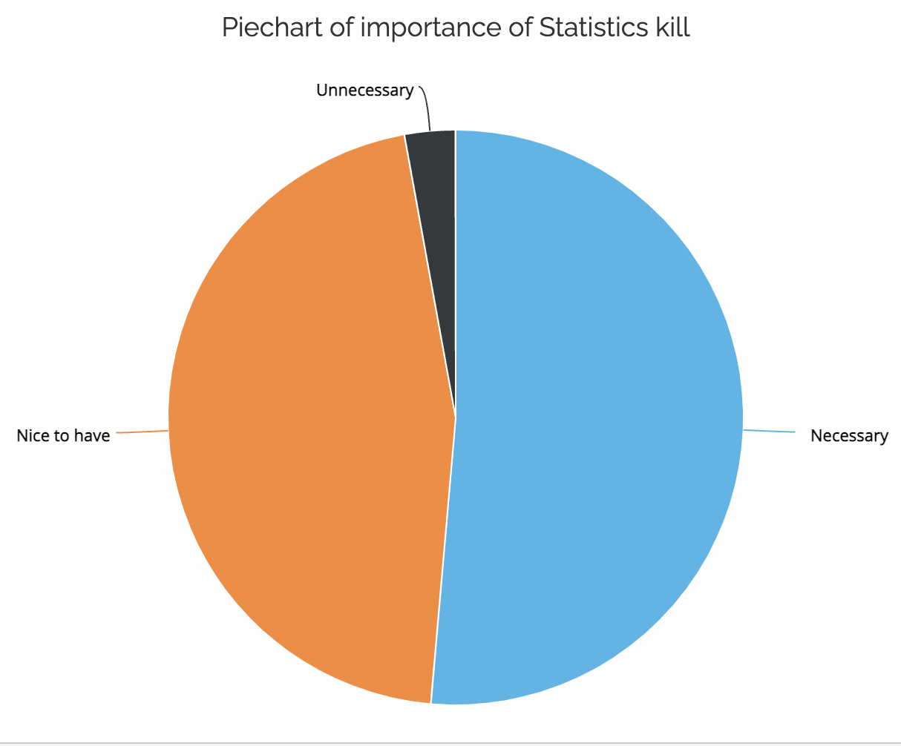
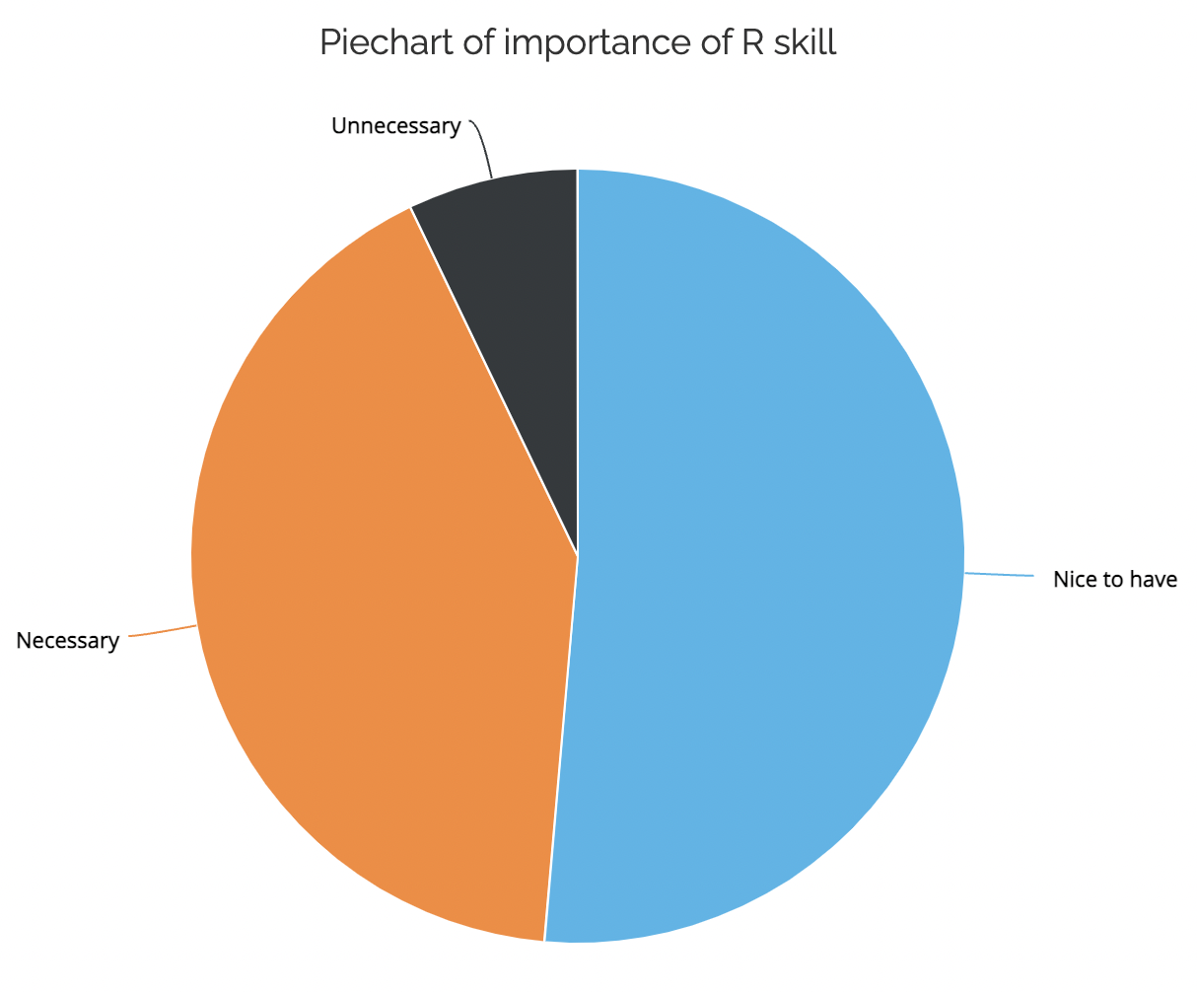
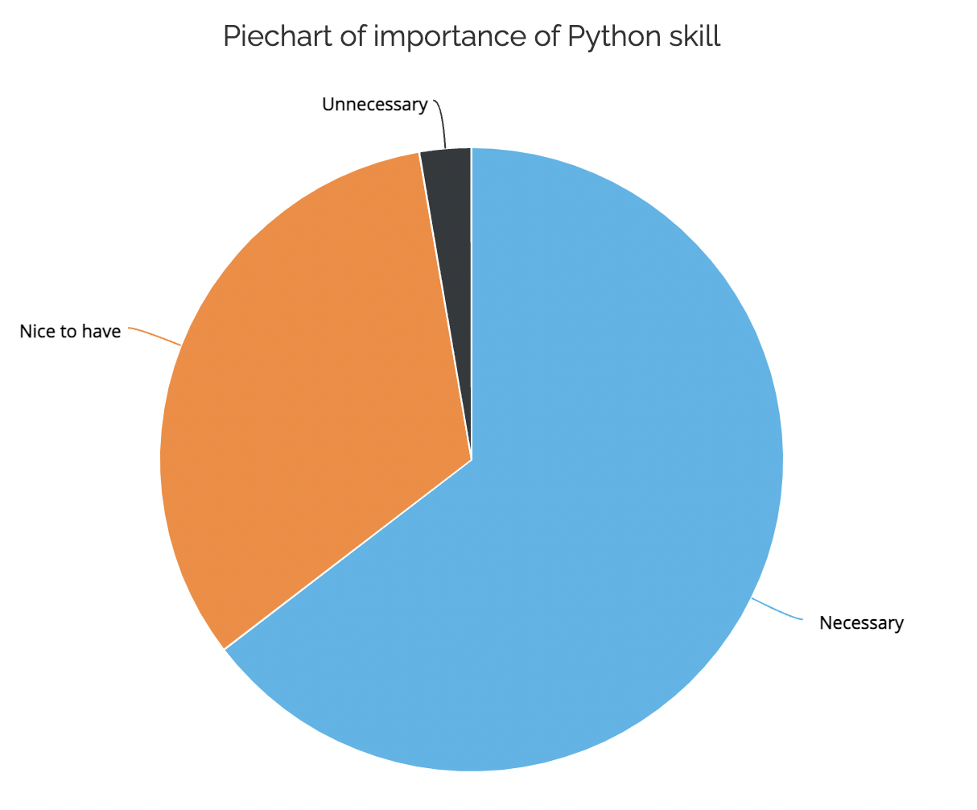
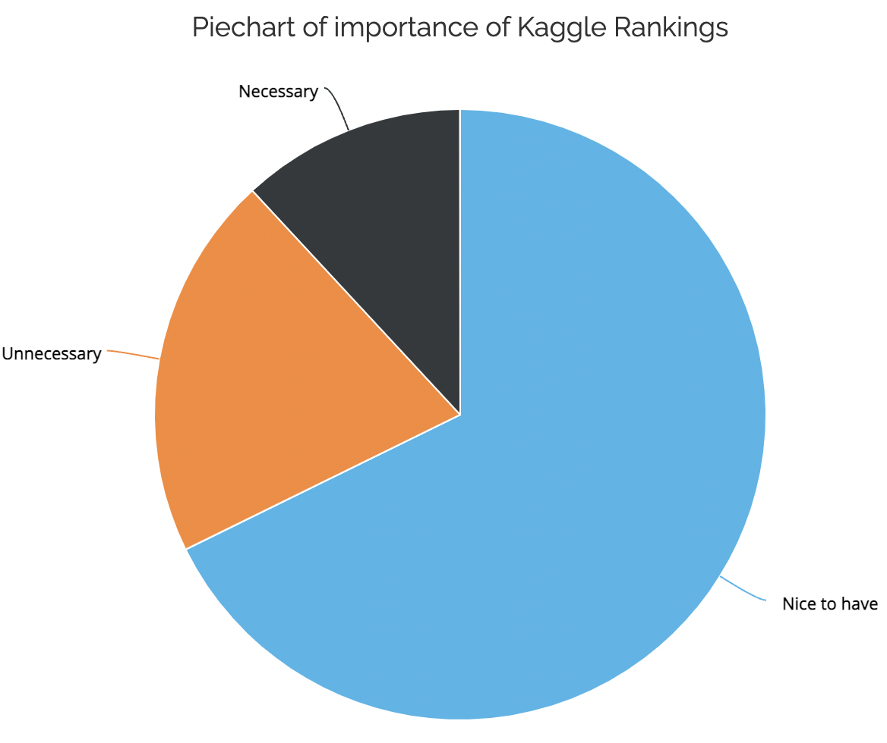
Observations

Slide 8
Results and Conclusion
RShiny Web App
As part of our model prediction, we have used Linear Regression, Random Forest and XGBoost Regression Techniques with Train-Validation-Test Split as 60:20:20
R-Squared error values of
Linear Regression - 0.79
Random Forests Regressor - 0.85
XG Boost Regressor - 0.87
Even though our XG boost performed well, Random Forests took comparatively lesser time XG Boost.
We have developed RShiny interactive Web app to visualize our results
We have created multiple tabs for user to view all the plots category-wise that we have plotted as part of our EDA.

Slide 9
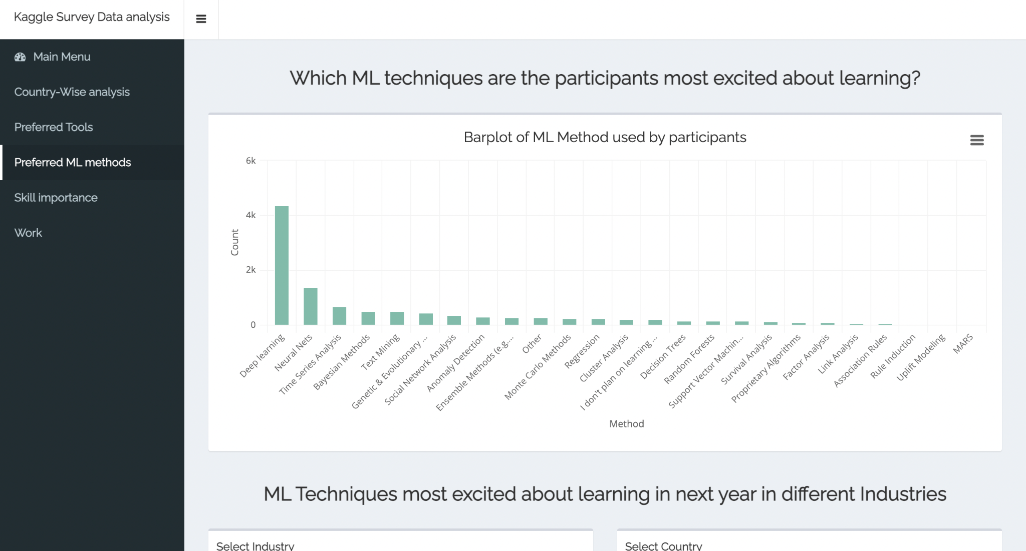
RShiny Web App Screenshots

Slide 10
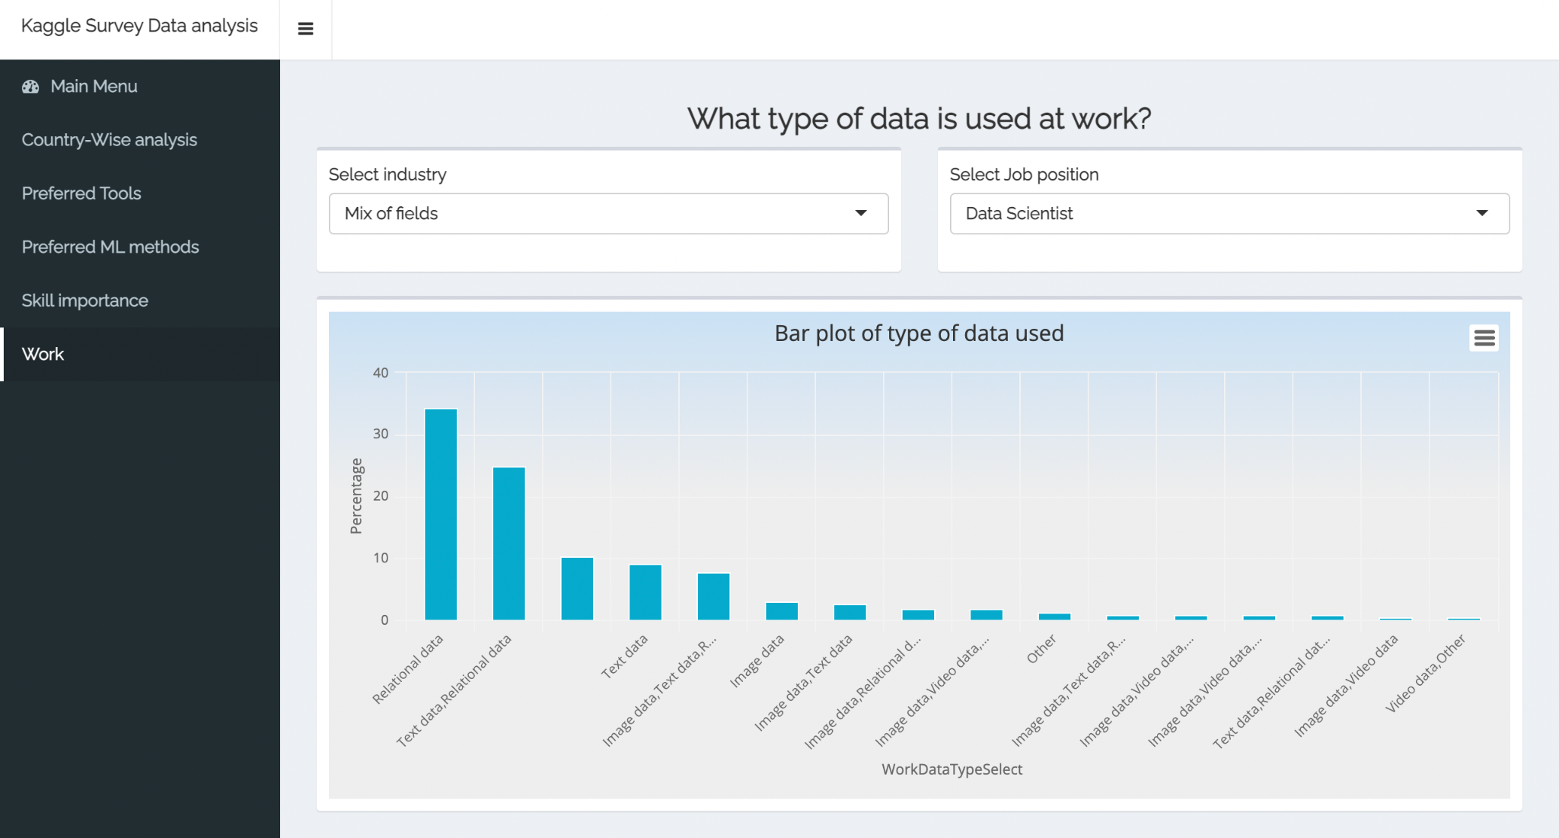
RShiny Web App Screenshots

